Slide 1
PUBLIC RACE
PUBLIC RACE
25th-27th July 2025

Slide 2
Organizers
Partners

Slide 3
Sponsors

Slide 4
Honorary patronage

Slide 5
EUOC 2025 - Łódź

Slide 6
Venue
Poland, Łódź
Organizer
European University Sports Federation (EUSA)
Polish Orienteering Federation
Academic Sport Association
UKS Orientuś Łódź
City of Łódź
Organizing Committee
Event Director/President OC Łukasz Charuba
Technical Director / Vice-President Beata Winczewska
Sports Director Rafał Podziński
Referee Director Piotr Chmielecki
Permits and Compliance Coordinator Monika Ciupa

Slide 7
Course setter
Sprint, Middle, Sprint Relay Rafał Podziński
Event Advisers
EUSA Technical Delegate Dušan Vystavěl
Polish Orienteering Federation Technical Delegate Tadeusz Piłkowski
SCAC
SCAC Chair Dusan Vystavel, EUSA Orienteering Technical Delegate
SCAC Member Hristina Hristova (Kiki) - EUSA Projects and Communications Officer
SCAC Member Eszter Gulyas - EUSA Sports Coordinator
SCAC Member Beata Winczewska - EUC 2025 OC Representative
SCAC Member Lukasz Charuba - EUC 2025 OC Representative
CTC Chair Dusan Vystavel - EUSA Orienteering Technical Delegate
CTC Member Tadeusz Pilkowski as the National Controller
CTC Member Piotr Chmielecki as the Main Referee
CTC

Slide 8
Poznański Palace

Slide 9
PUBLIC RACE
The EUOC Public Race is organized to offer the public the chance to experience the spectacular moments of the EUOC 2025 and compete with the champions of the future in the same terrain.
Date | Event | Where | Address | Start
July 26, Saturday | Middle | Brus ex-military training ground | ul. Minerska 19, 94-304 Łódź | 13:30
July 27, Sunday | Sprint | EC1 | ul. Targowa 1/3, 90-022 Łódź | 13:30
Races are prepared by Rafał Podziński, Course Setter for EUOC 2025 so do not miss the chance to compare yourself with the EUOC 2025 athletes!
Date | Event | Courses and categories | Characteristics | Length
July 26, Saturday | Middle | Long, EUOC course | technically difficult routes for professionals, individual start | 5,9km
 |  | Short | short routes for those who are just starting their adventure with orienteering, individual start | 2,8km
July 27, Sunday | Sprint | EUOC course | technically difficult routes for professionals, mass start | 3,6km
All races are organized to allow participants to watch the arrivals and attend flower ceremonies of EUOC 2025, which, take place on the same maps and competition arenas.

Slide 10
Applications
https://euoc2025.orientuslodz.pl/publicrace-start-list.php
Prices for individual race
For EUOC officials and athletes – free
For non-EUOC crew – 50zł/course paid in the Event Center
Public Race Event Center
On Saturday, 26th of July
from 12:30, ul. Krańcowa 19 Łódź (51.76378071439487, 19.39985545687656)
On Sunday, 27th of July
from 12:30, east side of Dworzec Łódź Fabryczna (51.76937553496516, 19.47249199977575)
Time limit
Middle: 90 minutes
Sprint: 60 minutes

Slide 11
General info for public race
Each competitor is provided with: access to toilets, a professional orienteering map, and measurement of the correctness of completing the route.
Sending an application means accepting these regulations and committing to complying with them.
Everyone starts in the race at their own risk with full awareness of the possible dangers and risks associated with it. The participant undertakes to comply with sanitary and epidemiological requirements.
The Organizer is insured against civil liability and does not bear the costs of individual insurance, which it recommends to each participant.
The Organizer is not responsible for items left in the competition center.
The participant of the competition consents to the processing of his/her personal data in accordance with the understanding of the act for purposes related to the event.
The Organizer reserves the right to conduct interviews with each participant, take photos and film them for advertising, promotional purposes, use on the Internet or in radio and television broadcasts and for other commercial purposes.
The Organizer reserves the right to use all photos, film materials, interviews and audio recordings presenting the participants of the race free of charge worldwide. They may be used by the Organizer by placing them on CD-ROM, DVD, in catalogs and media, on websites, in newspapers and at exhibitions, as well as for promotional and advertising purposes related to the activities conducted by the Organizer.IX. In accordance with art. 13 sec. 1 and sec. 2 Regulation (EU) 2016/679 of the European Parliament and of the Council of 27 April 2016 on the protection of natural persons with regard to the processing of personal data and on the free movement of such data, and repealing Directive 95/46/EC (General Data Protection Regulation, hereinafter referred to as GDPR) we inform you that the Controller of the personal data of the participants is the Student Sports Club "Orientuś", ul. Janosika 136, 92-108 Łódź. The personal data of the participants will be processed for the purposes of organizing and conducting the competition, selecting the winner and awarding, issuing, receiving and settling the prize and other activities related to the activities of the Club and will not be made available to other recipients. The participant has the right to access the content of their data and to correct it. Providing personal data and expressing consent to their processing is voluntary, but necessary to achieve the above-mentioned purposes. Failure to provide data or lack of consent to their processing prevents participation in the competition. We inform you that the consent expressed may be revoked at any time. The personal data of the event participants will be used in accordance with the conditions specified in Regulation (EU) 2016/679 of the European Parliament and of the Council of 27 April 2016 on the protection of natural persons with regard to the processing of personal data and on the free movement of such data, and repealing Directive 95/46/EC (General Data Protection Regulation, hereinafter referred to as GDPR). The processing of participants' data, in connection with participation in the competition, also includes the publication of the participant's first and last name, year of birth, club with the name of the town where he or she resides.
The participant agrees to receive information from the organizer regarding the event.
In case of disputes regarding the cycle, the final decision belongs to the main judge.
The organizer reserves the right to the final interpretation of these regulations.
In the event of unintentional situations not covered by these regulations, the organizer reserves the right to make changes to the regulations.
All information regarding the event will be published on the competition website: https://orienteering2025.eusa.eu/

Slide 12
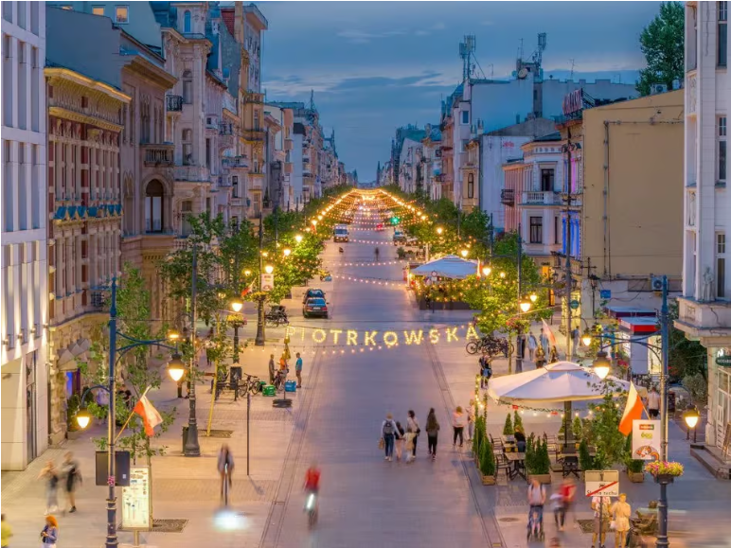
SEE YOU IN ŁÓDŹ!!

